Slide 1


Creating Opportunity in [PLACE]
New Insights from Big Data
Raj Chetty
Harvard University
[EVENT NAME] | [MONTH] [YEAR]

Slide 2





Takeaways for Increasing Opportunity Going Forward
Focus on Childhood Environment
Social Communities as Unit of Change
Invest in Social Capital
Provide opportunity-rich environments from birth to adulthood
Target communities that have historically lacked opportunity
Connect those who don’t have opportunity to those who do
Notes:
Optional depending on context

Slide 3

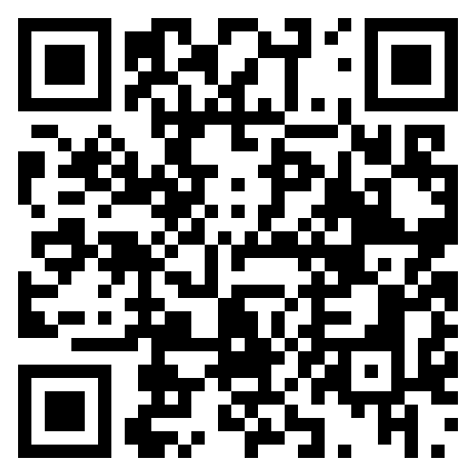



Explore your community’s data
Opportunity Atlas
Social Capital Atlas
Mobility Report Cards
Economic Tracker
Thank You
Scan to explore our resources:
Questions?
Email us at info@opportunityinsights.org
Sign up for office hours
Follow our latest work
X (Formerly Twitter) @OppInsights
BlueSky @Oppinsights.bsky.social
LinkedIn @Opportunity Insights
opportunityinsights.org/resources/

